Slide 1
Artificial Intelligence
To- Dr. Manasi Gyanchandani Mam
Name:Sharad Rai
Sch No:171112065
Class:CSE 1
Subject:

Slide 2
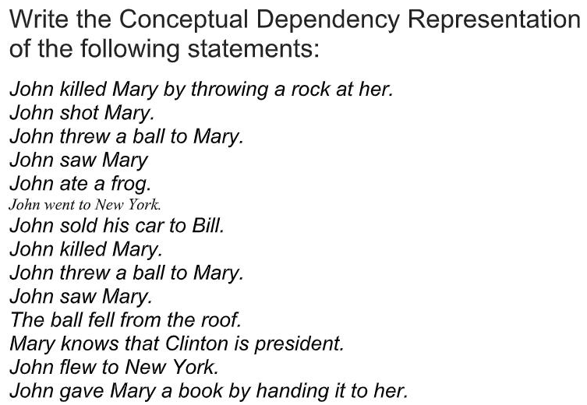
Question:

Slide 3
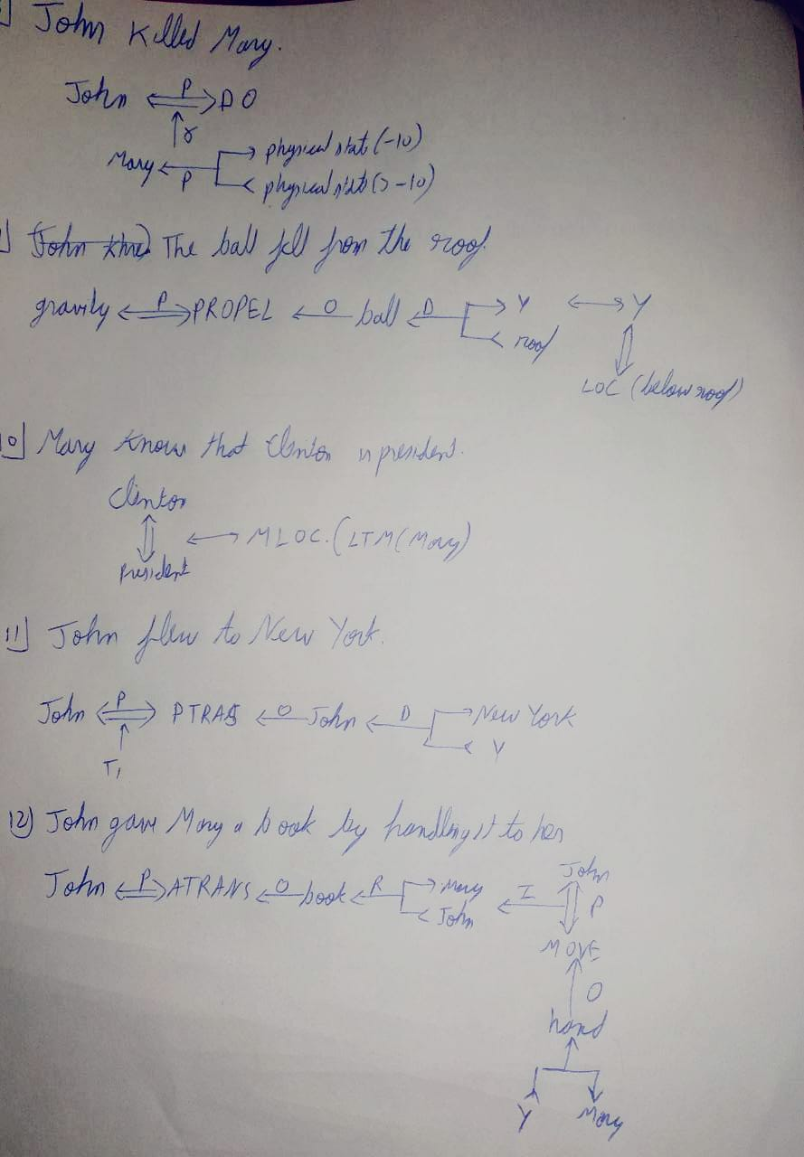
Solutions:

Slide 4
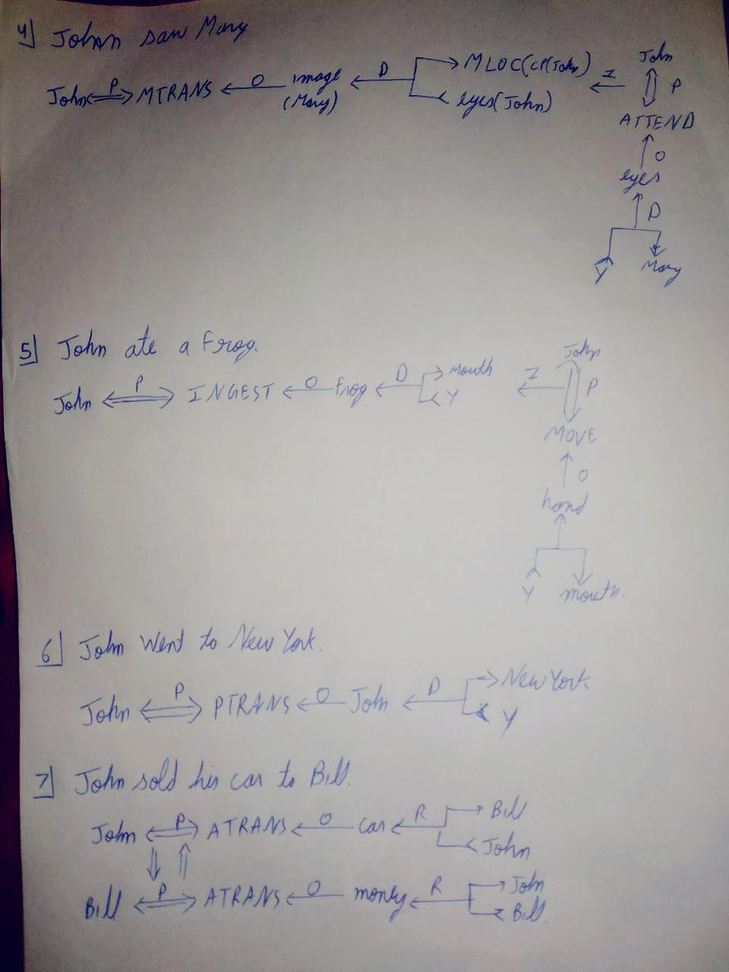
Solutions:

Slide 5
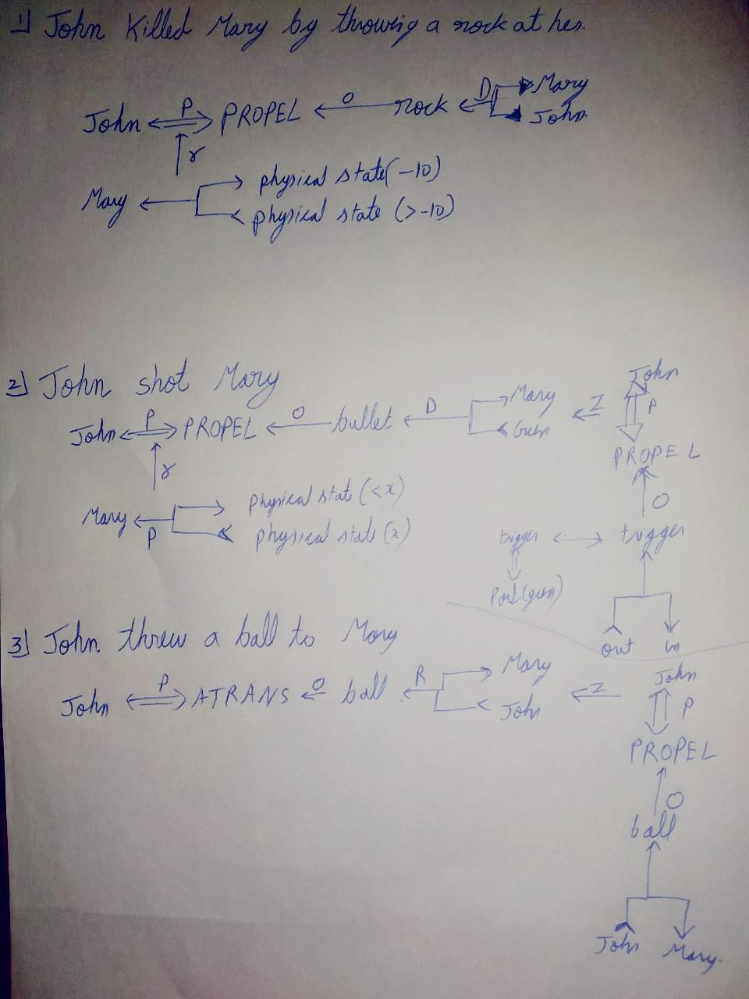
Solutions:

